Slide 1
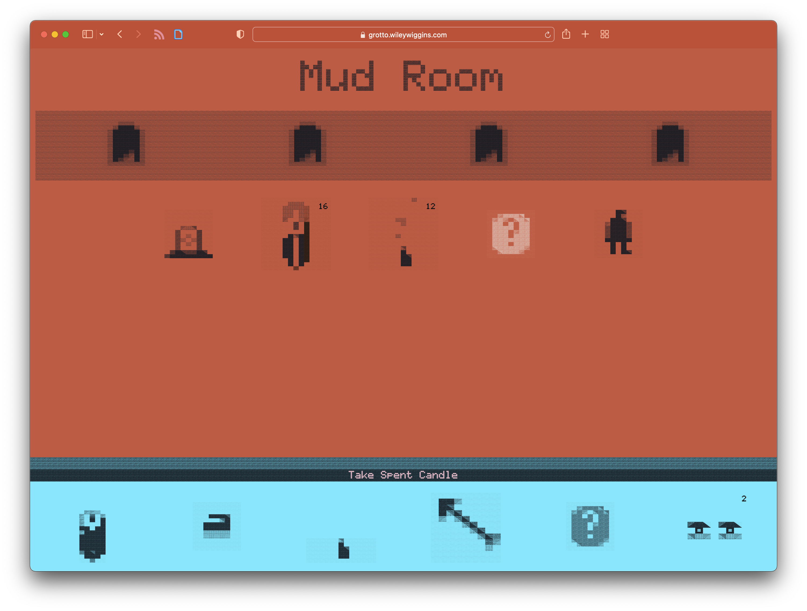
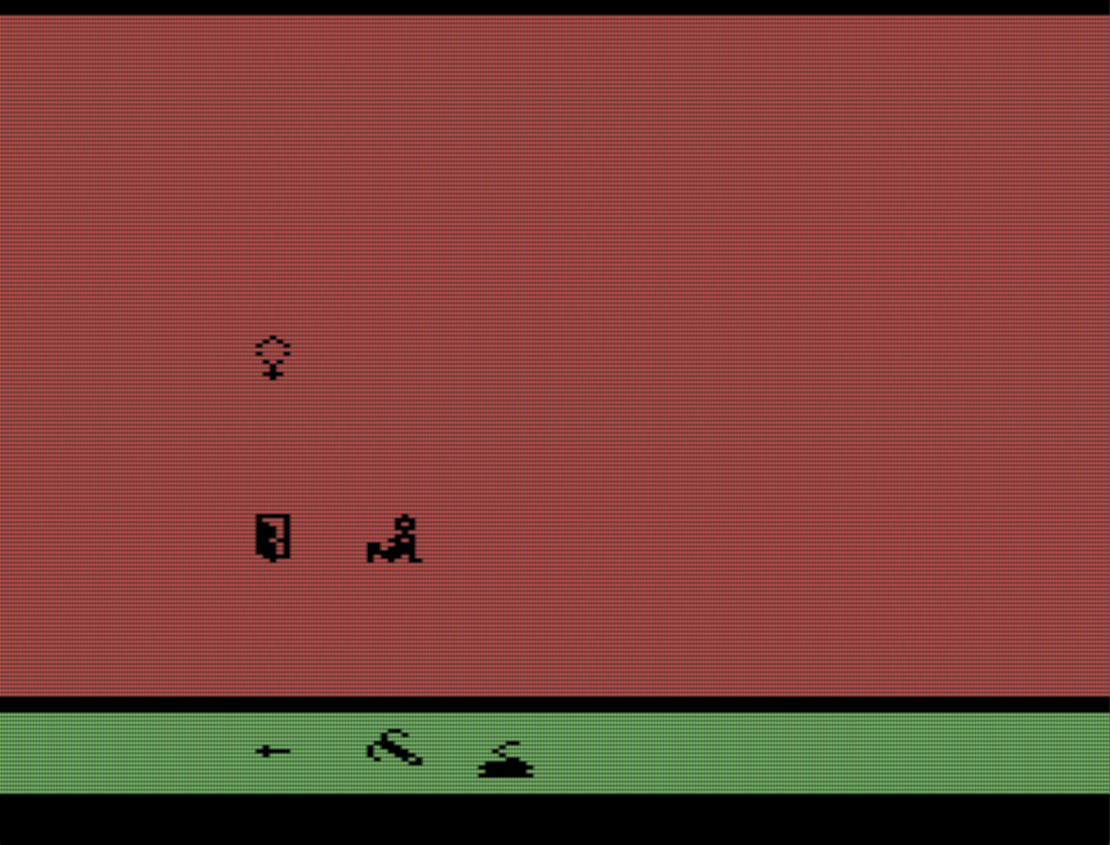
SwordQuest: Earthworld (Atari 2600)
Mud Room
Mud Room was a game installation that explored a childhood experience of video games overlaid on a confusing/frightening family tragedy
https://mudroom.rip
https://wileywiggins.com/mud_room.html

Slide 2
For this particular show, I was trying to recreate the mystery/confusion of SwordQuest so UI was left unexplained, here’s how it worked-
Exits
Things in the room
UI feedback text
Things in player
inventory
Very few people got it, which is ok.

Slide 3
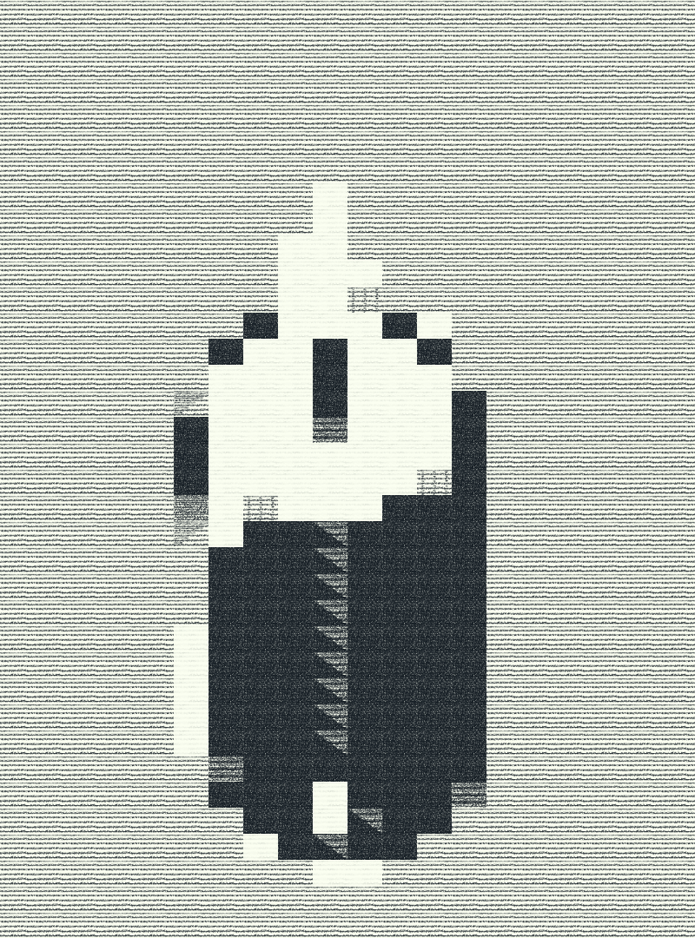
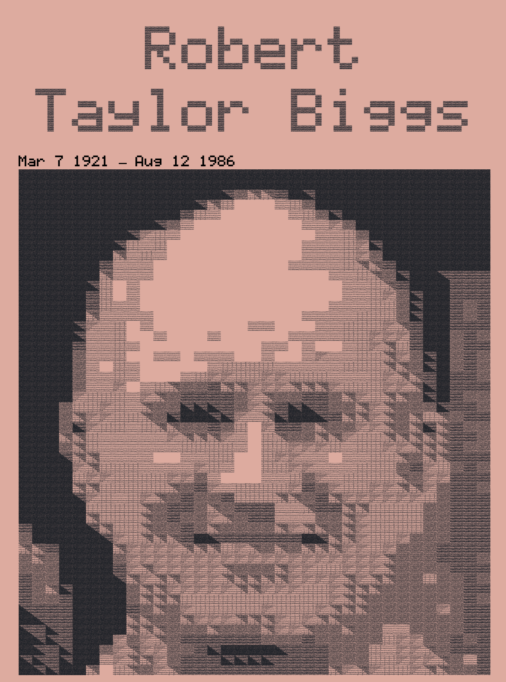
Look and feel came from Atari 2600 “wide pixels” crossed with pencil sketching,
Created a custom tool to do tile drawing with translucent sketch tiles squished a little
wider than tall. Original tool just exported png’s that could be turned into animated pngs and gifs. Source image analysis was added to quickly make a pass on video frames or images, turning them into tilemaps and saved as pngs.
Over time animation got added within the tool, which can be saved and loaded as json files.
Custom tile animation tool
https://github.com/wysiwyggins/scratchbeam

Slide 4
New Version -
Phantom Homeland (Grotto 1.0)
Building on same web application/tech project
Much bigger mazes- (from 15 rooms to 600+, with up/down stairs) loading genealogy data and making a map from family connections
We want players! UI should be legible now or explained w tutorial
It’s substrate for a memory work (archive)- Should be a platform for more writing, animation, audio
Animated png’s and gifs had a lot of drawbacks, keep graphics as tilemaps in canvas?

Slide 5
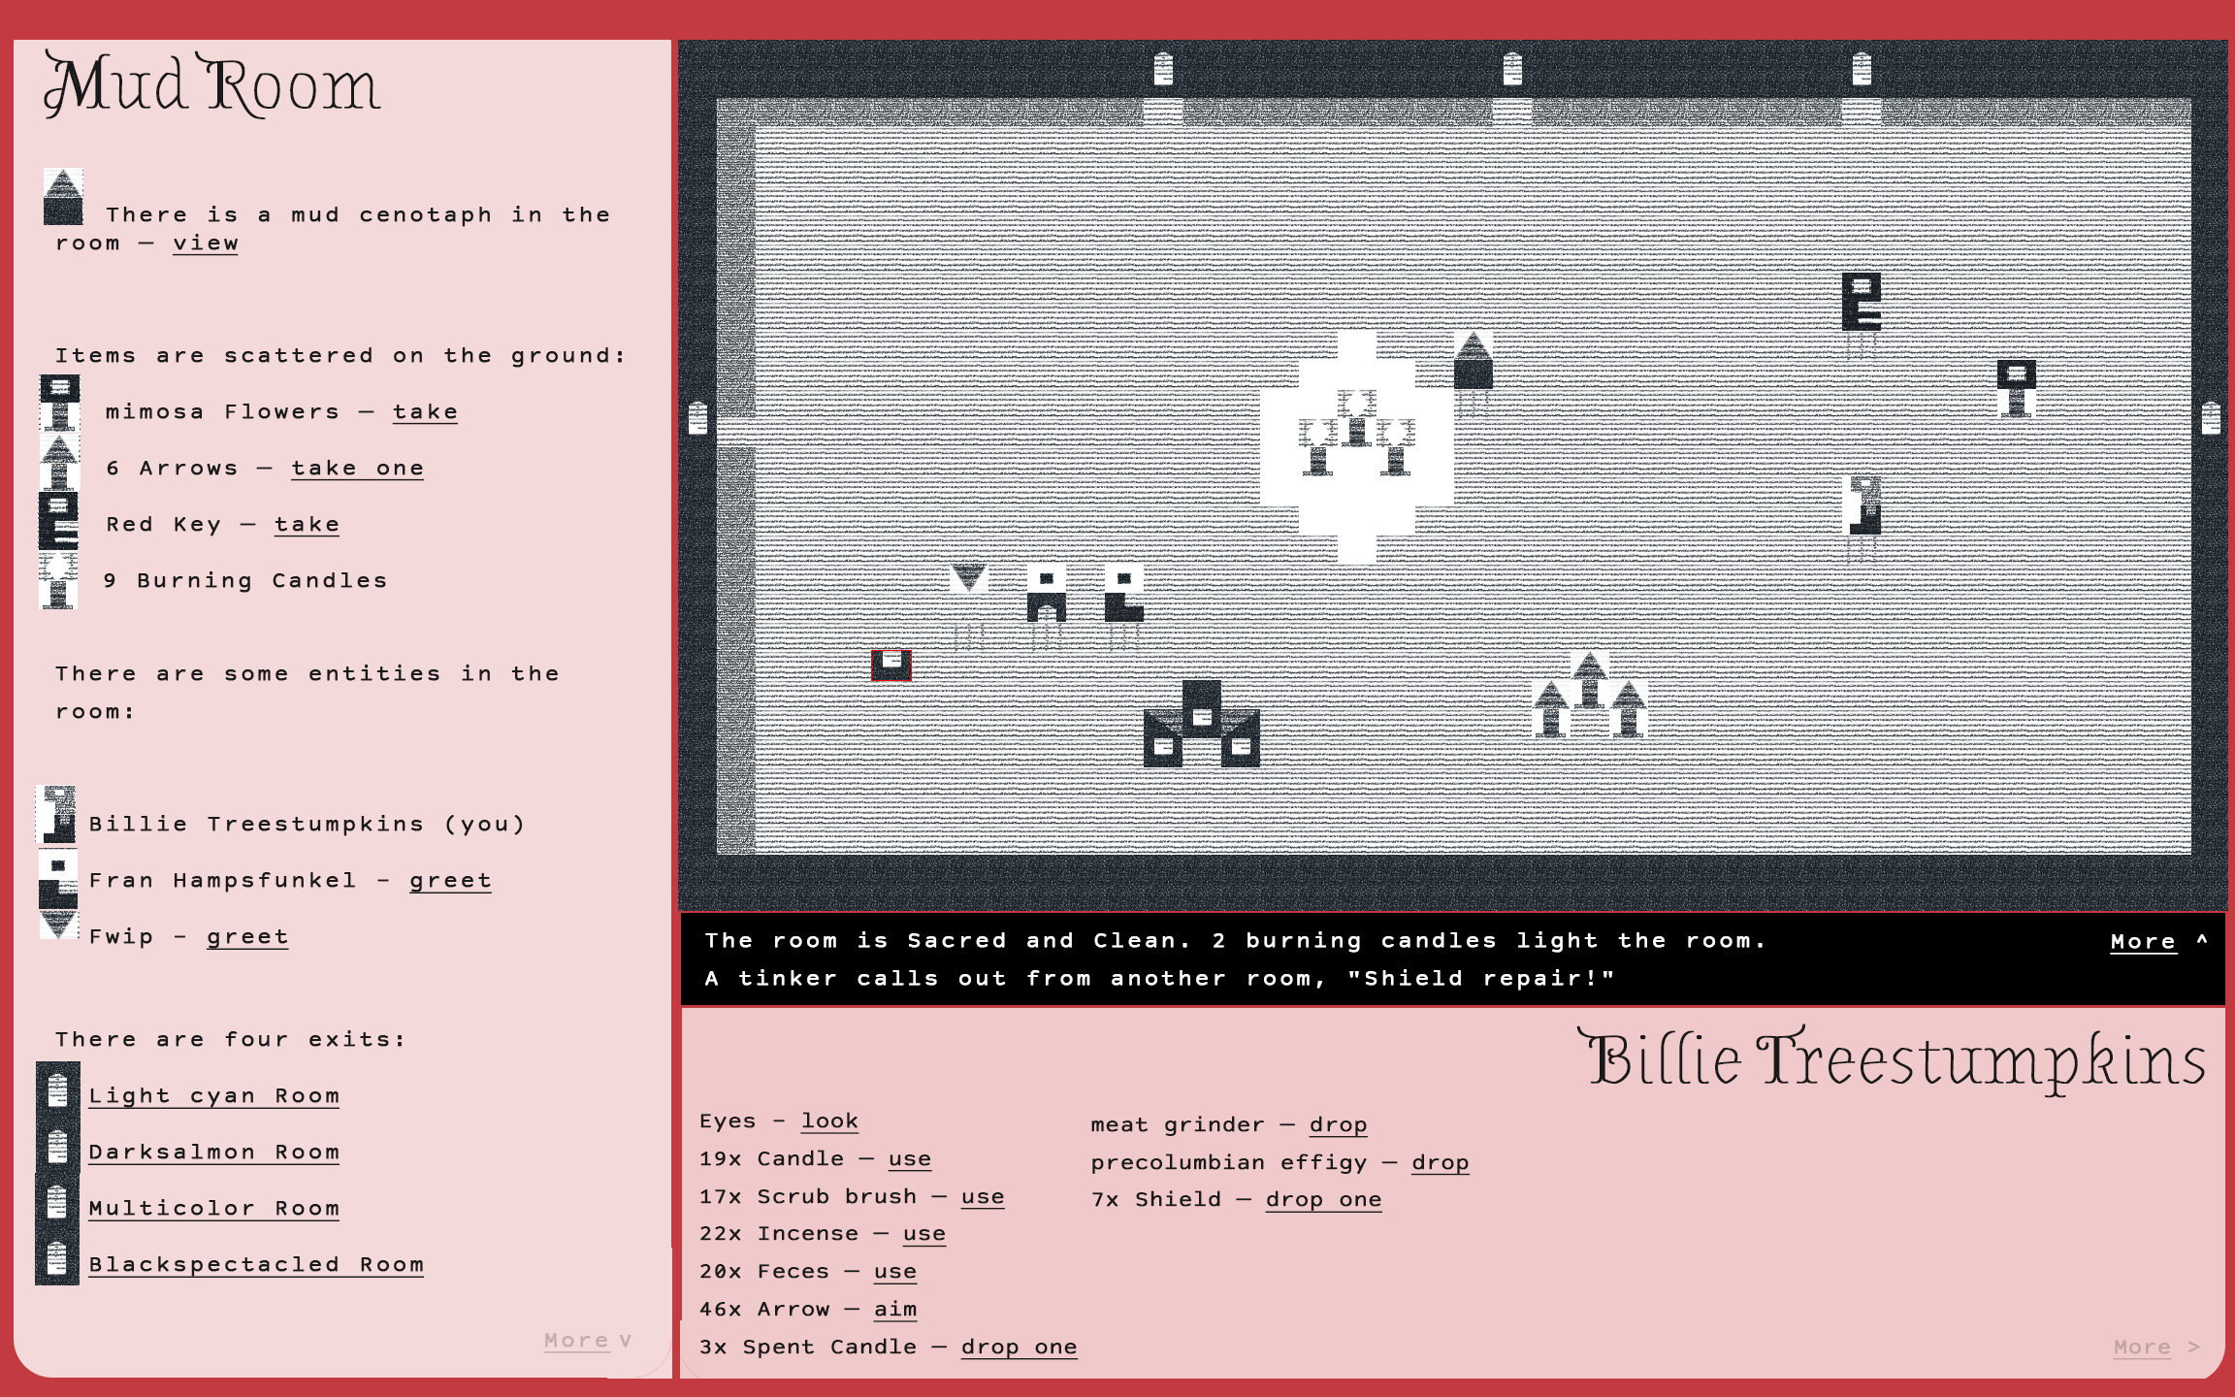
Super rough mockup of potential top-down version
Tilemap tool as graphics output??
Tool can now save animations as json
What if it could also draw from the api
To place sprites that represent room items
New graphics window could draw to a map view from the api
AND can show cutscene animations

Slide 6
Feature hopes
Embedded canvas version in game (no tools just view)
Background drawing and loading json animations
Place sprites on top (adds a new layer)
Connect it to the api
Define sprites in the tool
Load audio file in tool for animating, maybe include in animation json file too for playback
Horizontal flip function in tool?
Onion skin in the tool?

